Slide 1

WAY TO ENTERPRISE
React JS
VTI ACADEMY
Author: duy.nguyenngoc1@vti.com.vn
March 2020

Slide 2
Agenda
Deploy
Assignments
Copyright © VTI Academy All Rights Reserved

Slide 3
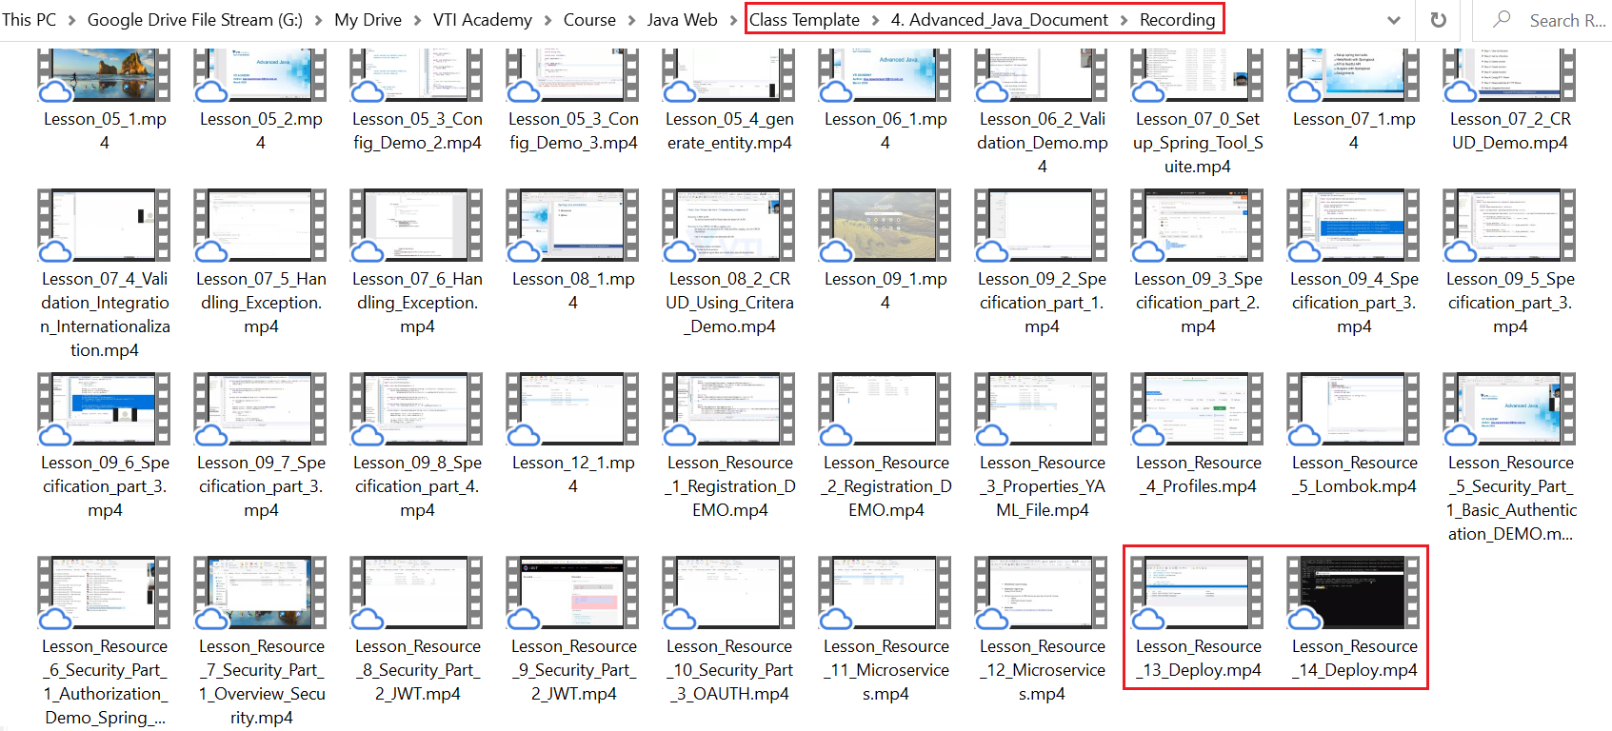
Deploy Backend
Deploy MySQL & Spring Boot

Slide 4
Deploy ReactJS
Deploy through Tomcat
Deploy through Cloud

Slide 5
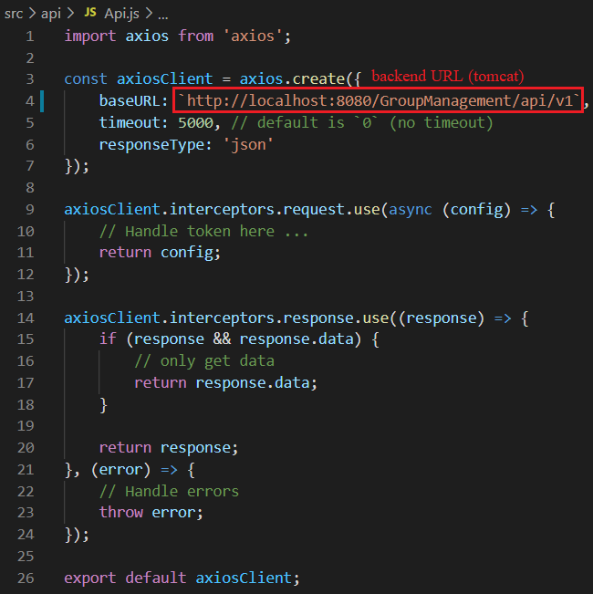
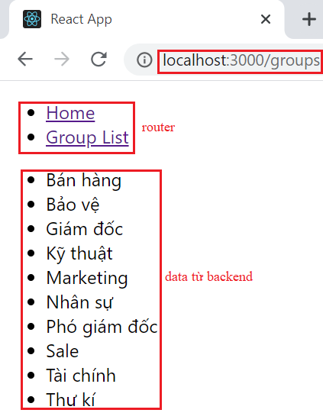
Deploy Through Tomcat
Prepare Front-end Project
Run the backend before running the front-end

Slide 6
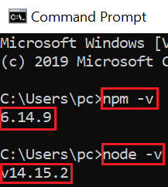
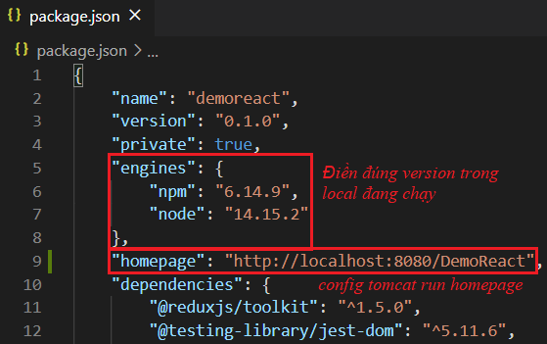
Deploy Through Tomcat
Build folder
Check npm & node version
Make sure npm & node version is correct for local machine

Slide 7
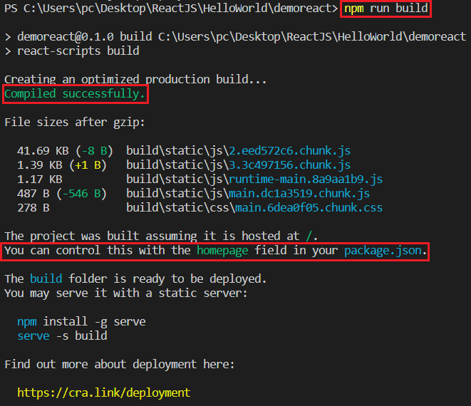
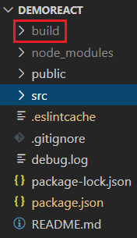
Deploy Through Tomcat
Build folder
npm run build

Slide 8
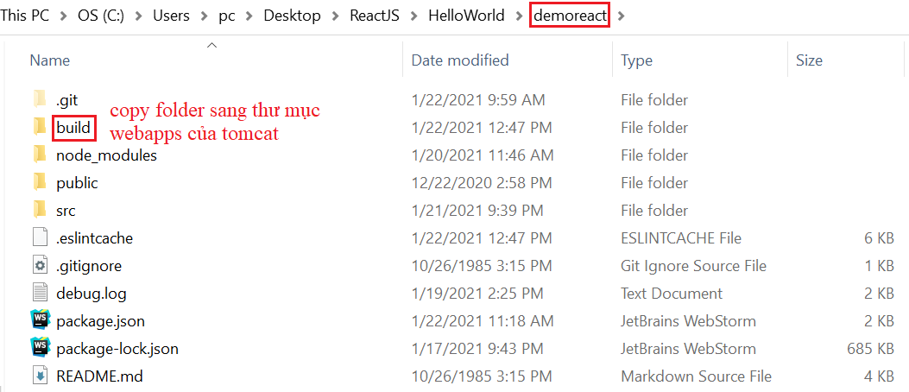
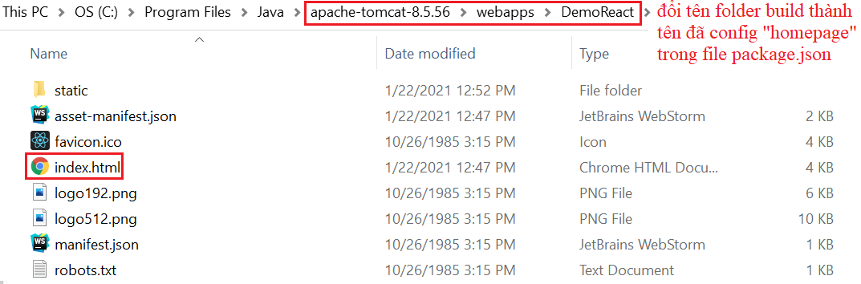
Deploy Through Tomcat
Deploy to Tomcat server (Windows)
Install tomcat on the server (similar to the backend)
Then copy the build directory to tomcat's webapps and rename the folder

Slide 9
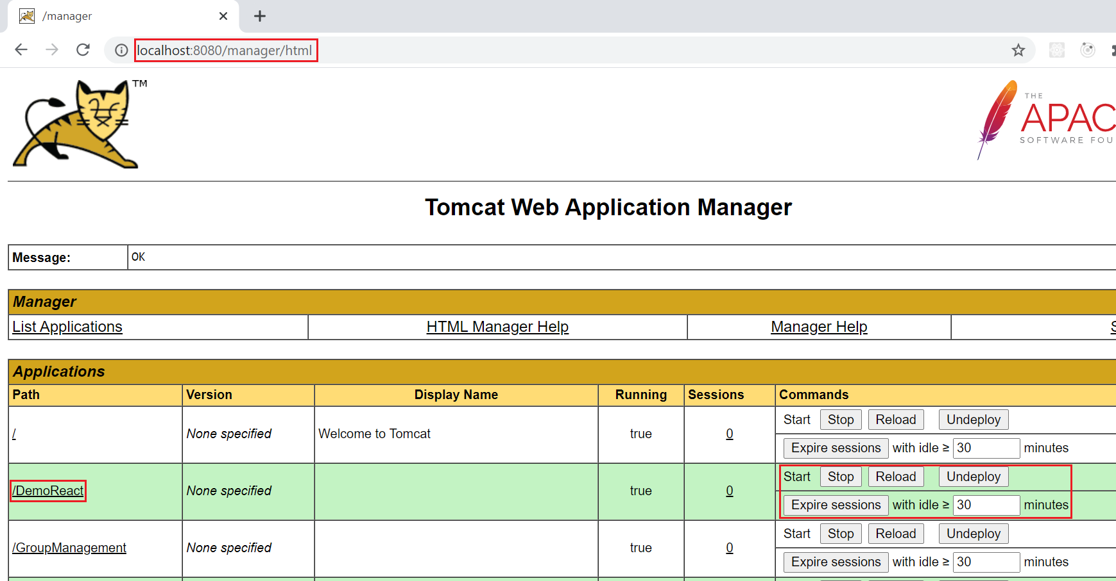
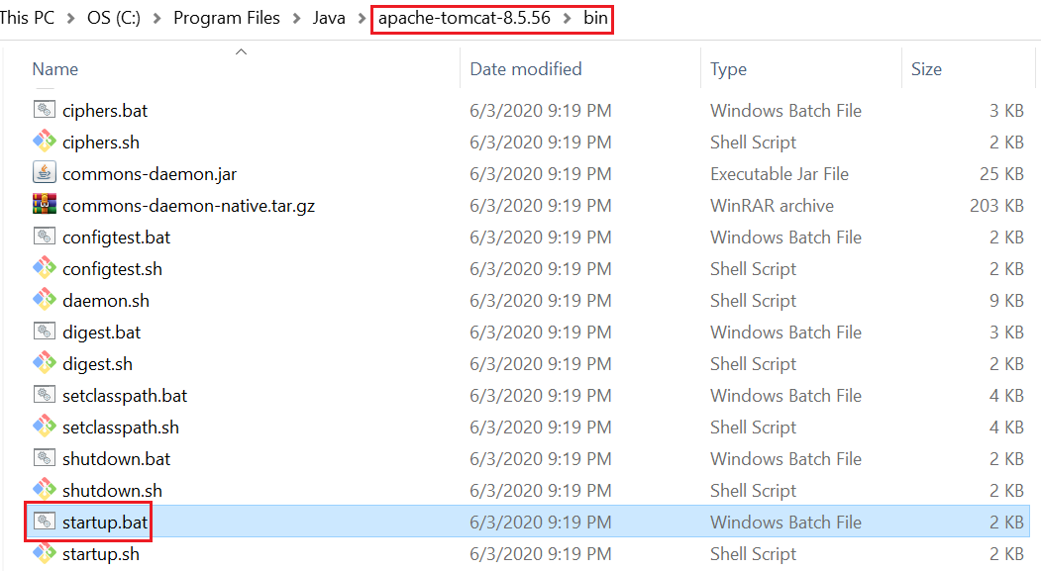
Deploy Through Tomcat
Deploy to Tomcat server (Windows)
Run tomcat

Slide 10
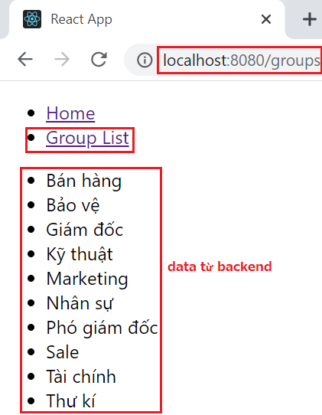
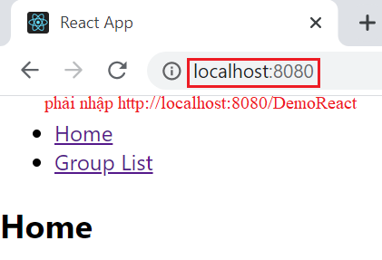
Deploy Through Tomcat
Deploy to Tomcat server (Windows)
Access by link: http://localhost:8080/DemoReact

Slide 11
Deploy Through Cloud
Cloud services
AWS Amplify
Azure
Firebase
GitHub Pages
Heroku
...
Netlify
Vercel
Render
S3 and CloudFront
Surge

Slide 12
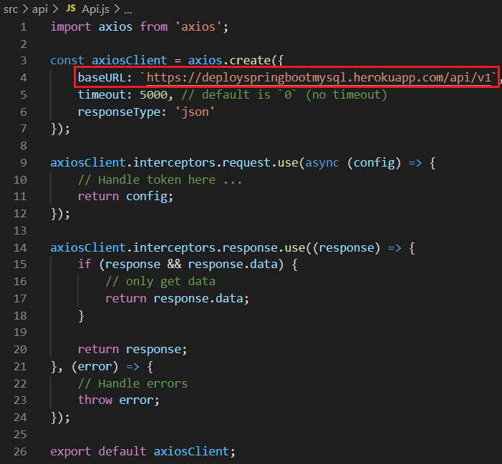
Deploy Through Heroku
Config project
Config API Link

Slide 13
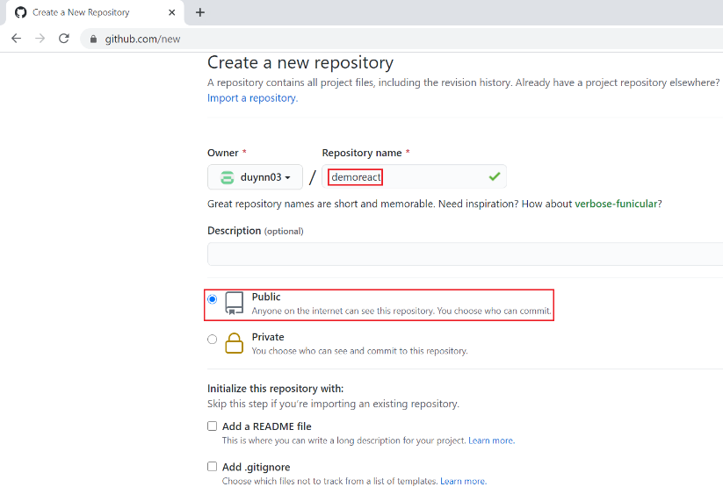
Deploy Through Heroku
Push code to Git
Create Git Repository

Slide 14
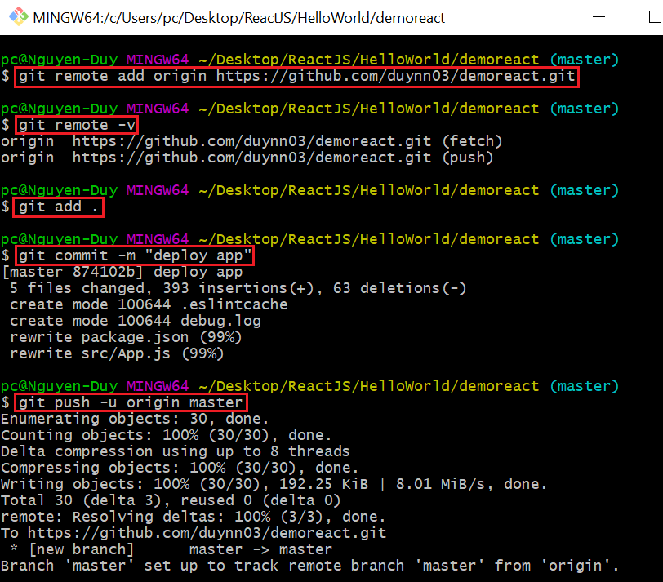
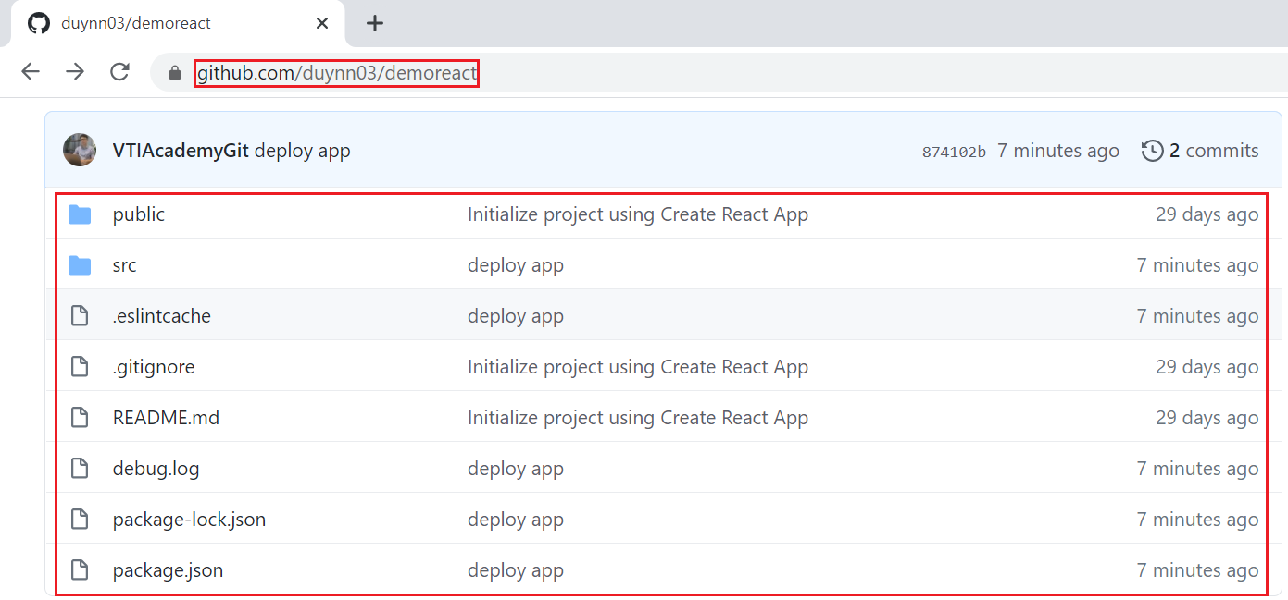
Deploy Through Heroku
Push code to Git
Link Local Repository to Remote Repository

Slide 15
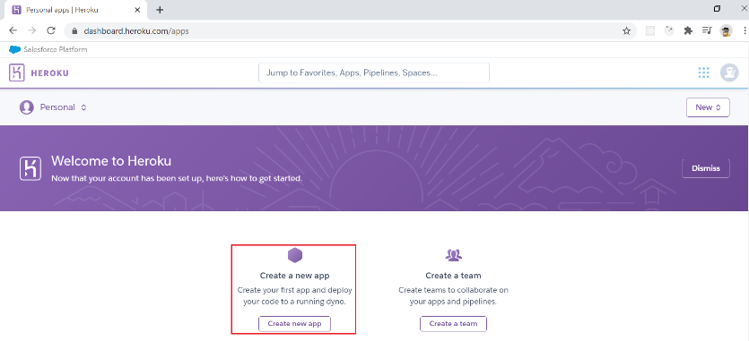
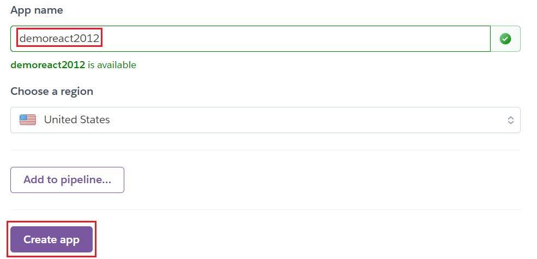
Deploy Through Heroku
Connect Git to Heroku
https://dashboard.herokuapp.com
Create Heroku Account

Slide 16
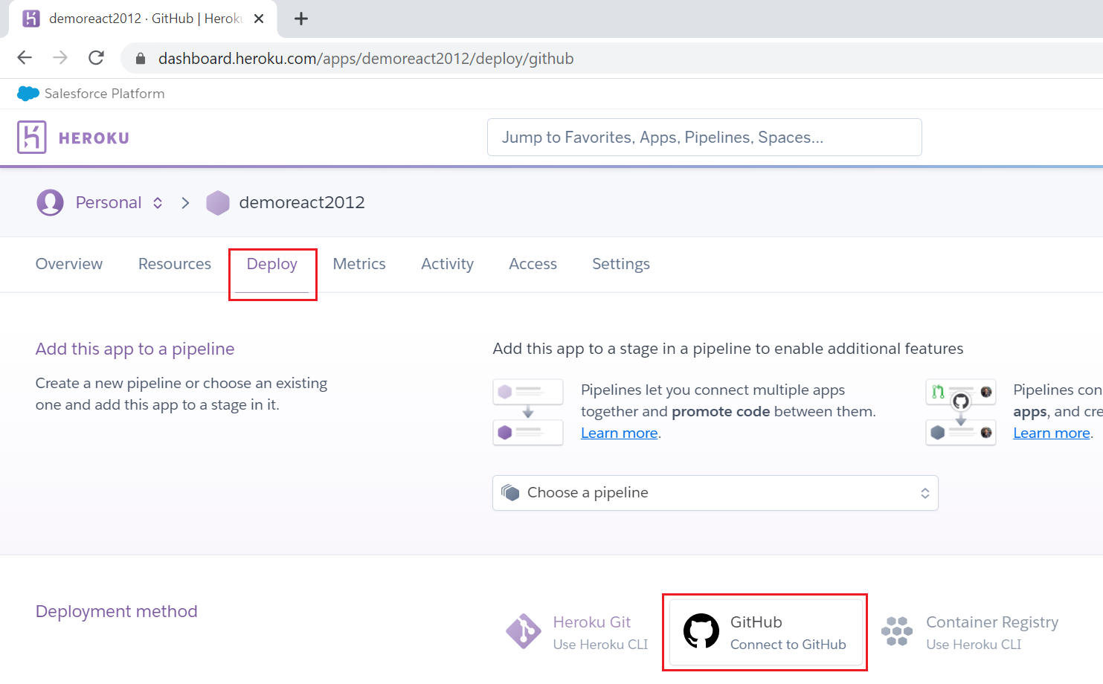
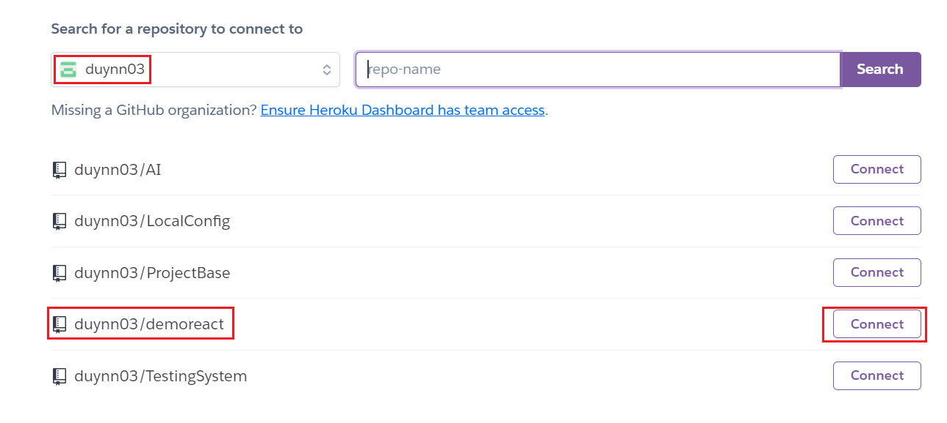
Deploy Through Heroku
Connect Git to Heroku
Connect Repository Git to Heroku

Slide 17
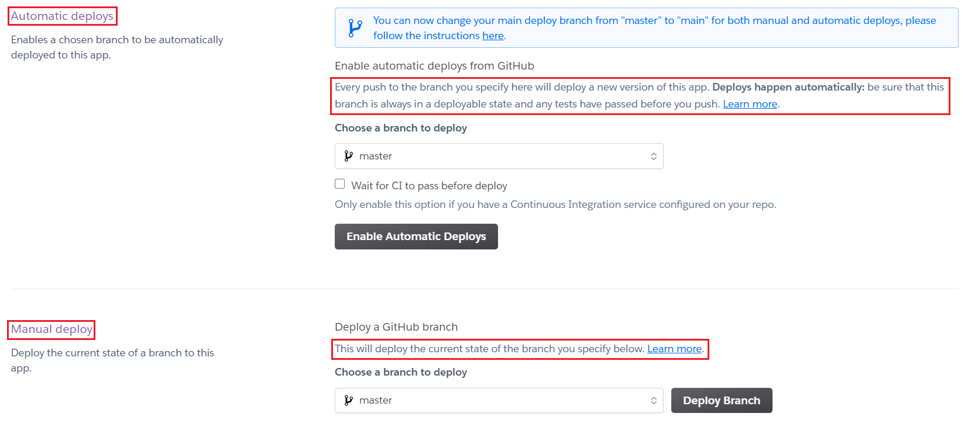
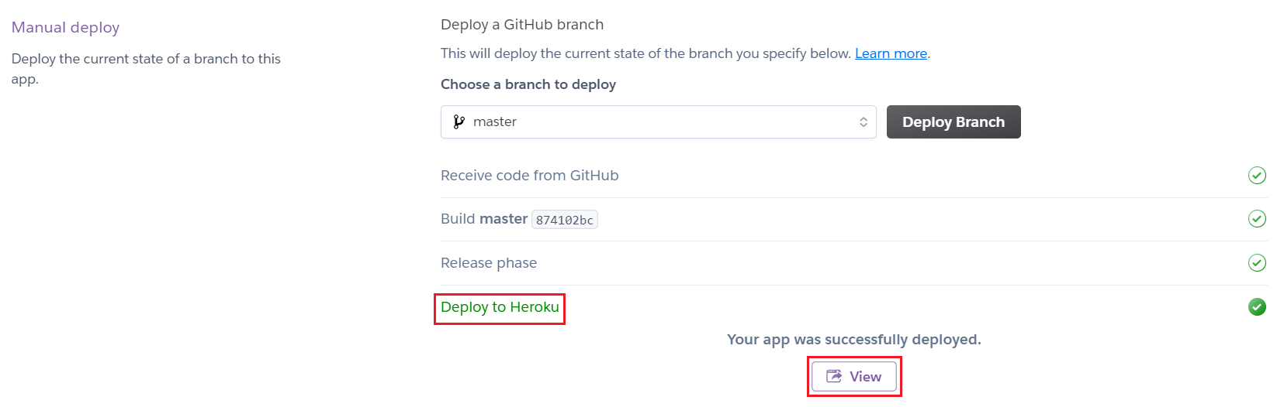
Deploy Through Heroku
Deploy
Successful Deploy

Slide 18
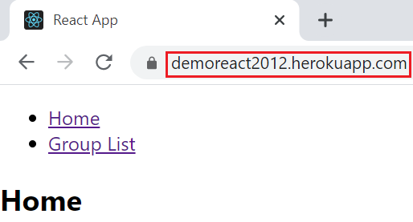
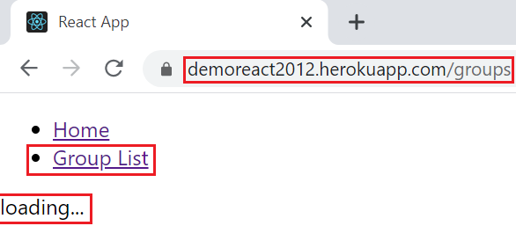
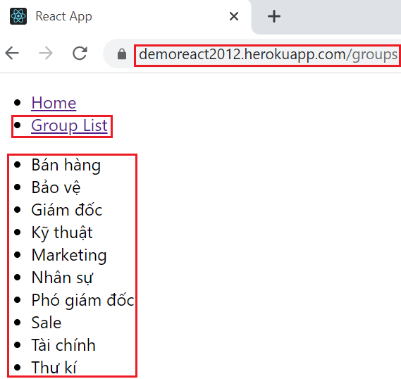
Deploy Through Heroku
Demo

Slide 19
Reference
https://reactjs.org/docs/getting-started.html
https://www.javatpoint.com/reactjs-tutorial
https://www.udemy.com/course/react-the-complete-guide-incl-redux

Slide 20
Q & A
Copyright © VTI Academy All Rights Reserved

